Slide 1
Software Engineering
Lecture-10

Slide 2
Software design and implementation
The process of converting the system specification into an executable system.
Software design
  Design a software structure that realises the specification;
Implementation
  Translate this structure into an executable program;

Slide 3
Agile methods
Dissatisfaction with the overheads involved in design methods led to the creation of agile methods. These methods:
  Focus on the code rather than the design;
  Are based on an iterative approach to software development;
  Are intended to deliver working software quickly and evolve this quickly to meet changing requirements.
Agile methods are probably best suited to small/medium-sized business systems or PC products.

Slide 4
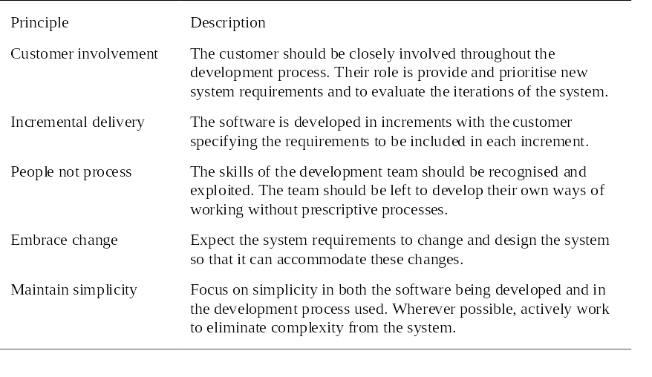
Principles of agile methods

Slide 5
Problems with agile methods
It can be difficult to keep the interest of customers who are involved in the process.
Team members may be unsuited to the intense involvement that characterises agile methods.
Prioritising changes can be difficult where there are multiple stakeholders.
Maintaining simplicity requires extra work.
Contracts may be a problem as with other approaches to iterative development.

Slide 6
Extreme programming
Perhaps the best-known and most widely used agile method.
Extreme Programming (XP) takes an ‘extreme’ approach to iterative development.
  New versions may be built several times per day;
  Increments are delivered to customers every 2 weeks;
  All tests must be run for every build and the build is only accepted if tests run successfully.

Slide 7
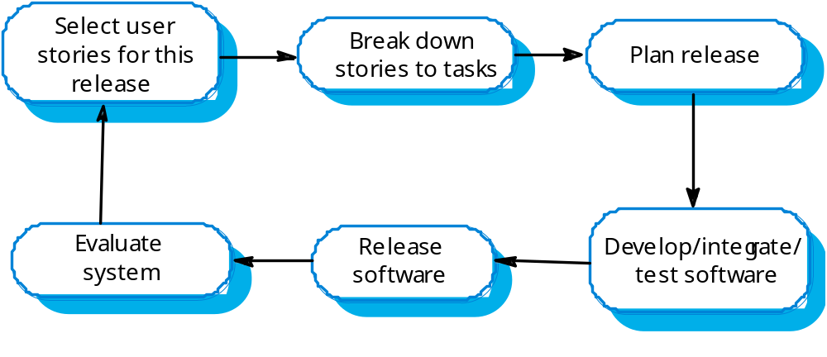
The XP release cycle

Slide 8
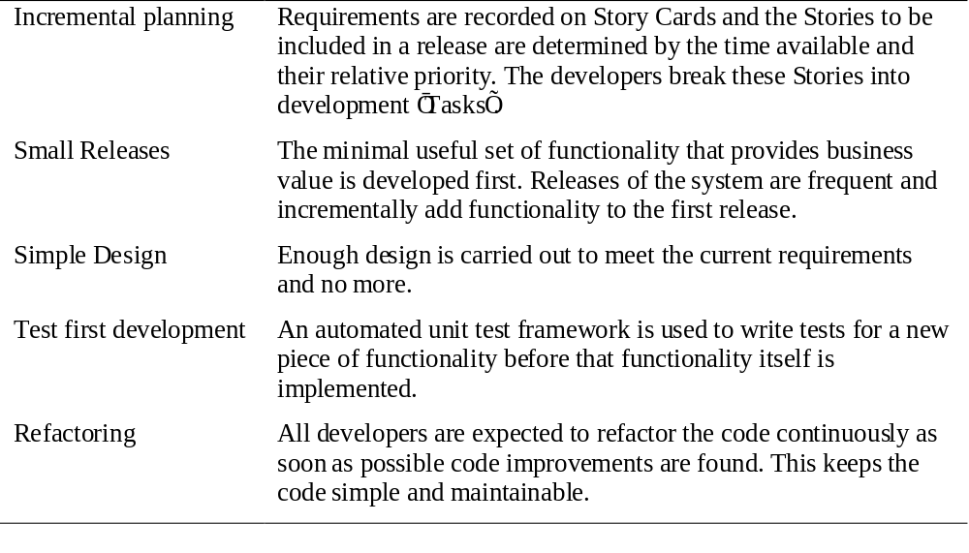
Extreme programming practices 1

Slide 9
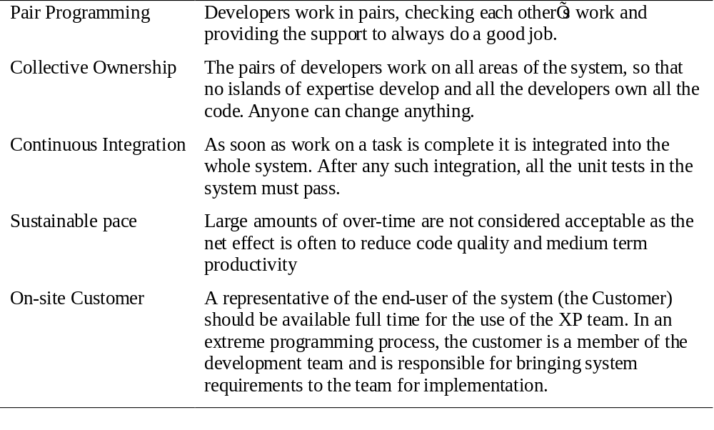
Extreme Programming practices 2

Slide 10
XP and Agile principles
Incremental development is supported through small, frequent system releases.
Customer involvement means full-time customer engagement with the team.
People not process through pair programming, collective ownership and a process that avoids long working hours.
Change supported through regular system releases.
Maintaining simplicity through constant refactoring of code.

Slide 11
Requirements scenarios
In XP, user requirements are expressed as scenarios or user stories.
These are written on cards and the development team break them down into implementation tasks. These tasks are the basis of schedule and cost estimates.
The customer chooses the stories for inclusion in the next release based on their priorities and the schedule estimates.

Slide 12
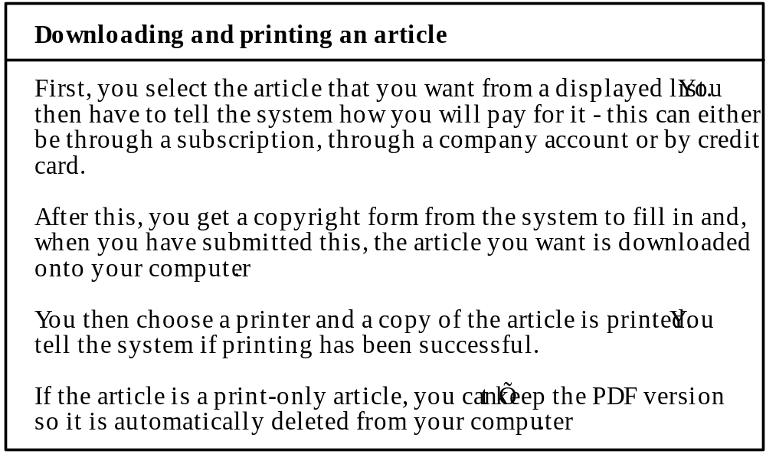
Story card for document downloading

Slide 13
XP and change
Conventional wisdom in software engineering is to design for change. It is worth spending time and effort anticipating changes as this reduces costs later in the life cycle.
XP, however, maintains that this is not worthwhile as changes cannot be reliably anticipated.
Rather, it proposes constant code improvement (refactoring) to make changes easier when they have to be implemented.

Slide 14
Testing in XP
Test-first development.
Incremental test development from scenarios.
User involvement in test development and validation.
Automated test harnesses are used to run all component tests each time that a new release is built.

Slide 15
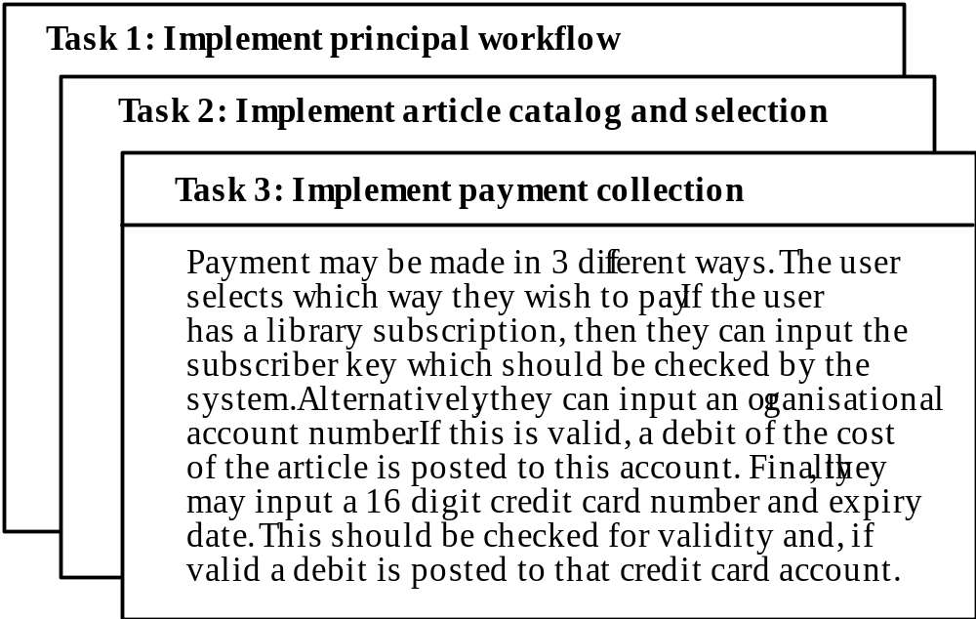
Task cards for document downloading

Slide 16
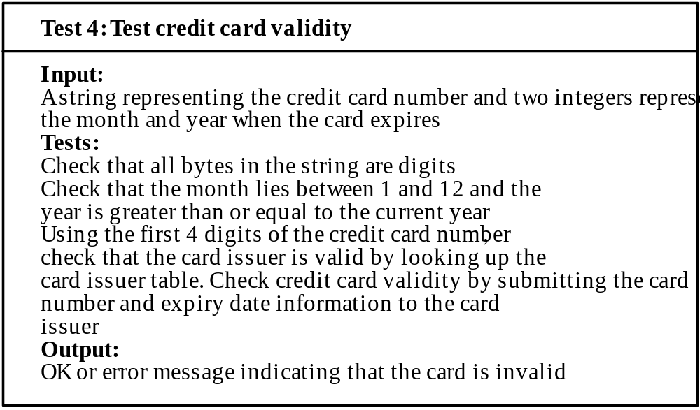
Test case description

Slide 17
Test-first development
Writing tests before code clarifies the requirements to be implemented.
Tests are written as programs rather than data so that they can be executed automatically. The test includes a check that it has executed correctly.
All previous and new tests are automatically run when new functionality is added. Thus checking that the new functionality has not introduced errors.

Slide 18
Pair programming
In XP, programmers work in pairs, sitting together to develop code.
This helps develop common ownership of code and spreads knowledge across the team.
It serves as an informal review process as each line of code is looked at by more than 1 person.
It encourages refactoring as the whole team can benefit from this.
Measurements suggest that development productivity with pair programming is similar to that of two people working independently.

